Slide 1

Using Yelp Data for Restaurant Mapping
Understanding Yelp restaurants in Pittsburgh and how wifi impact rankings.

Slide 2



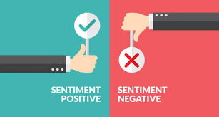
Original Plan
Twitter Data
Download twitter data to understand people’s perceptions of ride-hailing services such as Uber and Lyft.
Map perceptions based on sentiment, positive vs. negative sentiments to ride-hailing services.
Unfortunately the dataset I compiled did not have enough LAT and LONG values. Many tweets had no location identifier.

Slide 3
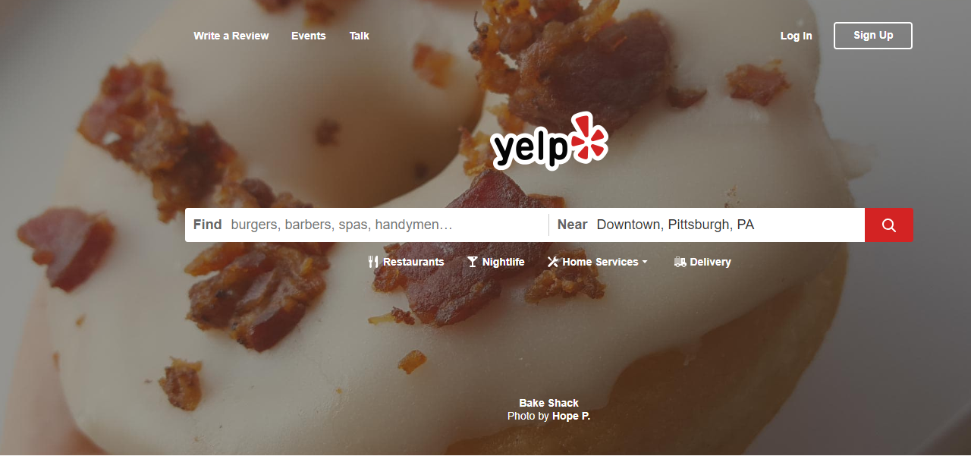

Slide 4
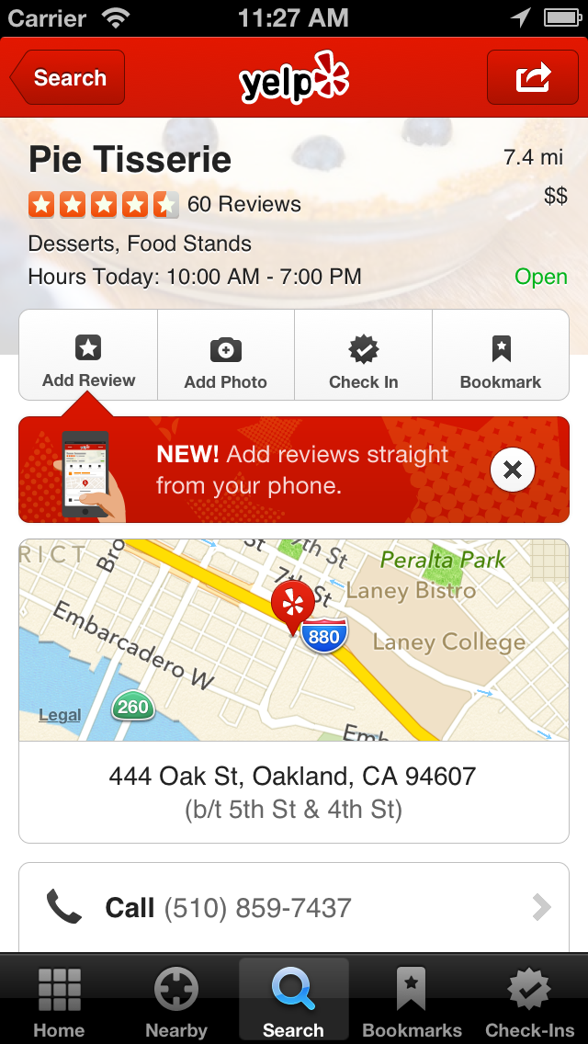
What is Yelp?
Yelp is a local-search service powered by a crowd-sourced review forum.
Stats
Yelp was started in 2004, and now has 26 million monthly active users. Yelp is present in over 200 cities and 32 countries.
Yelp Business Profile
Business Name
Categories (attributes)
Review Count
Stars
Location/ Map
Photos
Hours of Operation
Price Range
& More
Uses
Yelp users can find great local businesses like restaurants, dentists, hair stylists, and mechanics.

Slide 5
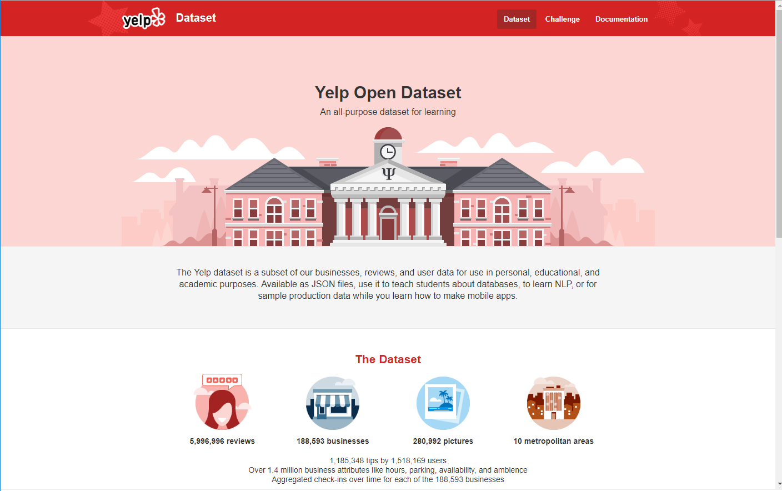
Data Collection: Yelp
Yelp hosts an open data research contest each year. They provide JSON files for 12 major cities, Pittsburgh was one of the cities with Yelp Data.

Slide 6
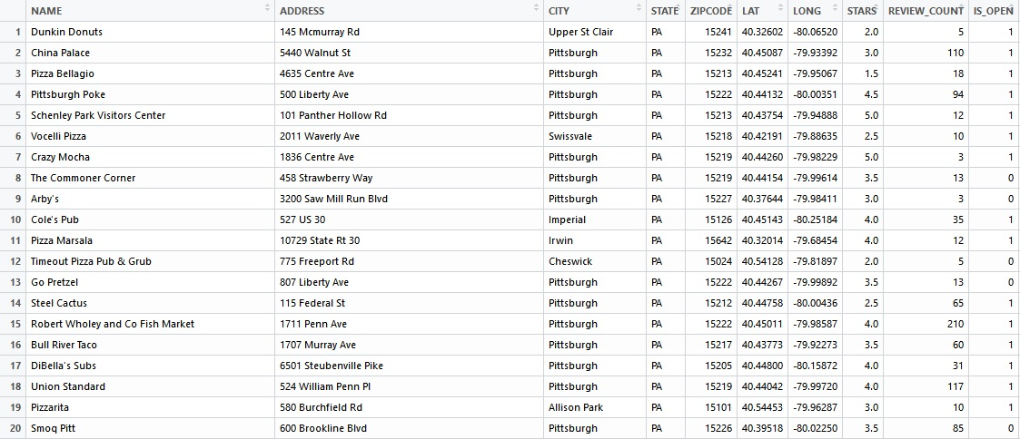
Data Collection: Yelp
Data Files:
Reviews
Users
Businesses
Photos
Checkin
Tip
Photo

Slide 7


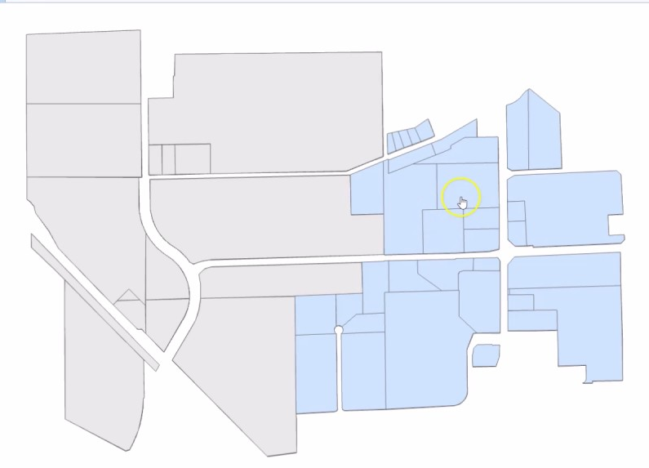
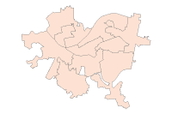


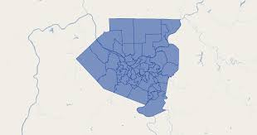

Data Collection: Shapefiles
Data Types
Pittsburgh Neighborhood (city)
Allegheny County Neighborhoods (region)
Streets
Parcels/ Building Footprints
Sources
Allegheny County, City of Pittsburgh
American Community Survey, United States Census Bureau
Western Pennsylvania Regional Data Center
Yelp, Pennsylvania Spatial Data Access

Slide 8
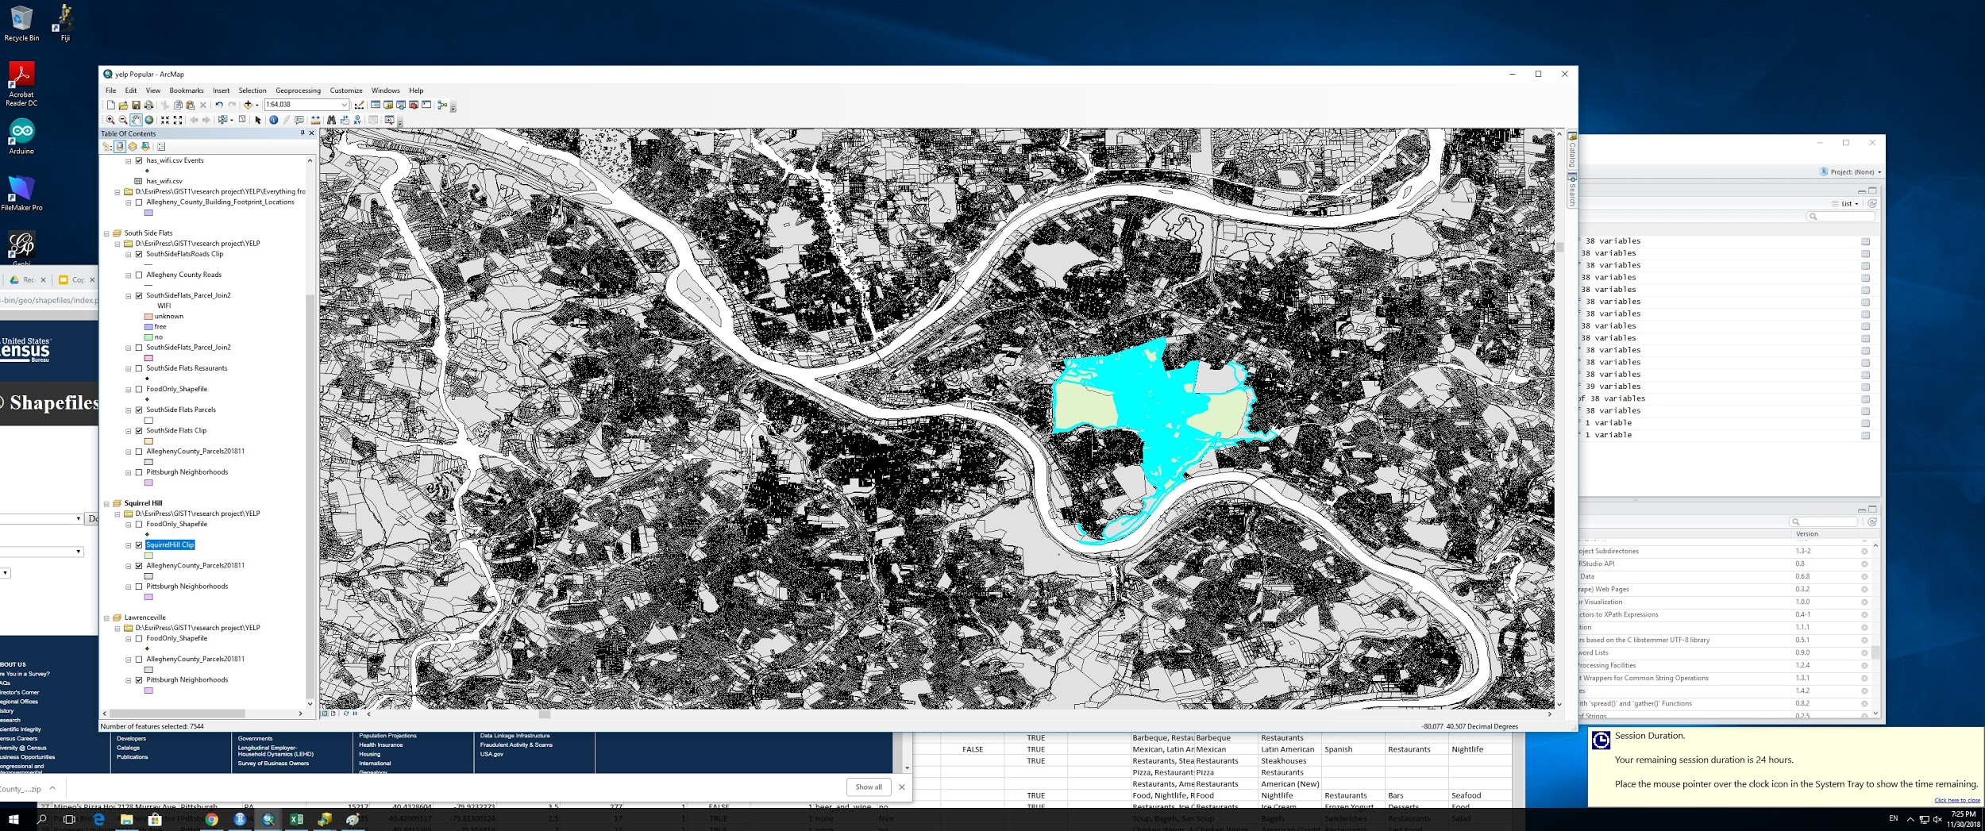

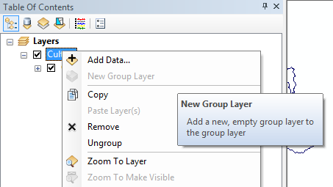
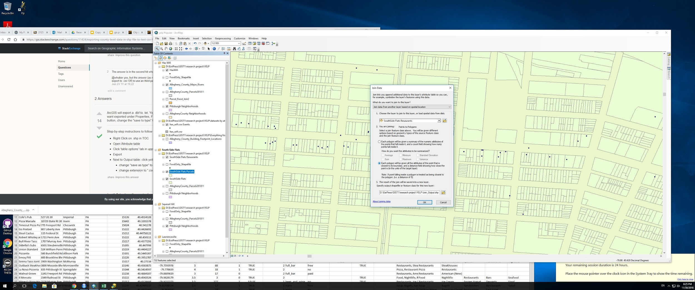

ArcMap Process
Download Yelp Dataset into R for cleaning.
Import all data tables and polygon layers into ArcMap.
Determine hypothesis/ question and test results.
Conducting spatial joins to analyze restaurants for each neighborhood.

Slide 9
Filtering Data
I used R to filter and clean data before uploading it to ArcGIS. The Yelp Dataset had to be converted from JSON format to CSV. Other filtering steps were needed to ensure that only Restaurants in Pennsylvania were chosen.
Yelp Restaurants in Allegheny County
Yelp
Restaurants in Pittsburgh
Yelp
Restaurants in Squirrel Hill
Yelp
Businesses
Yelp
Restaurants in Central Business District
Yelp
Restaurants
Yelp
Restaurants in South Side Flats

Slide 10
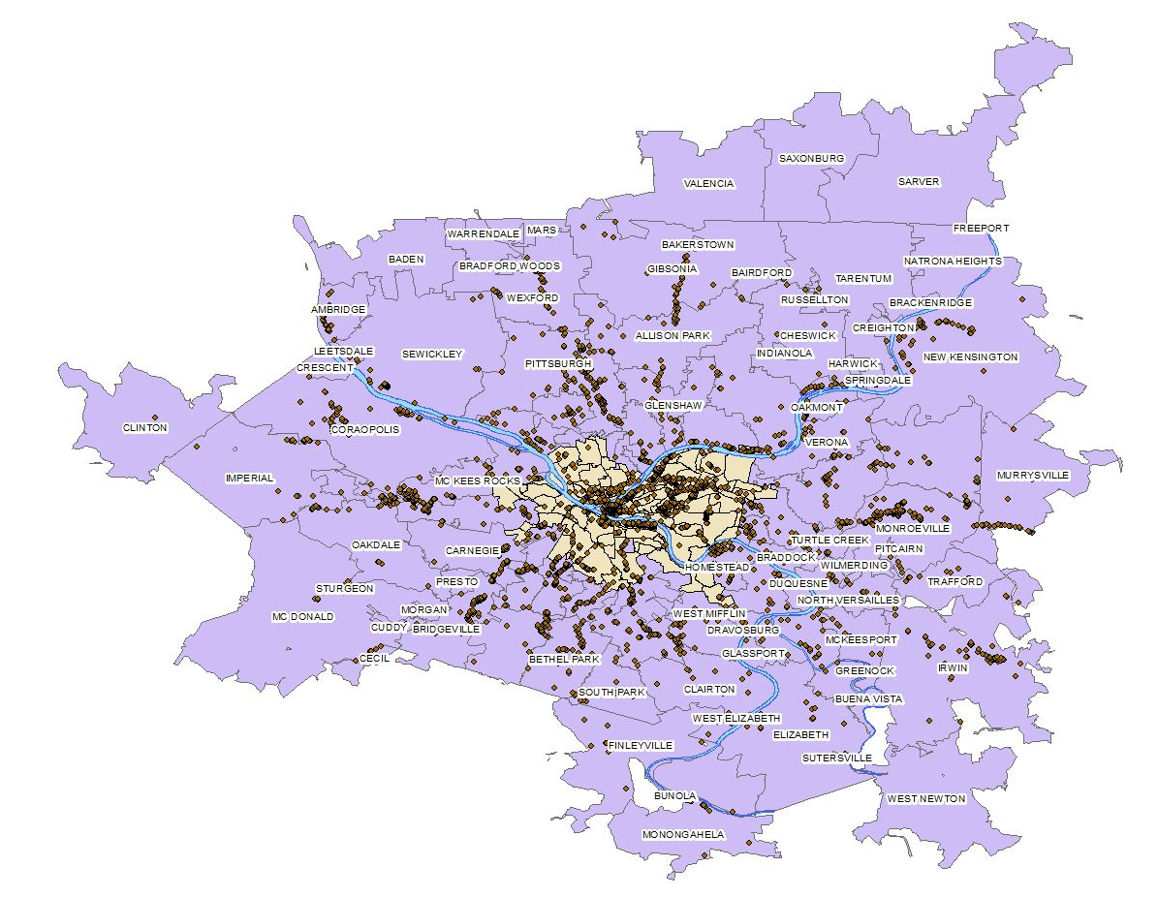
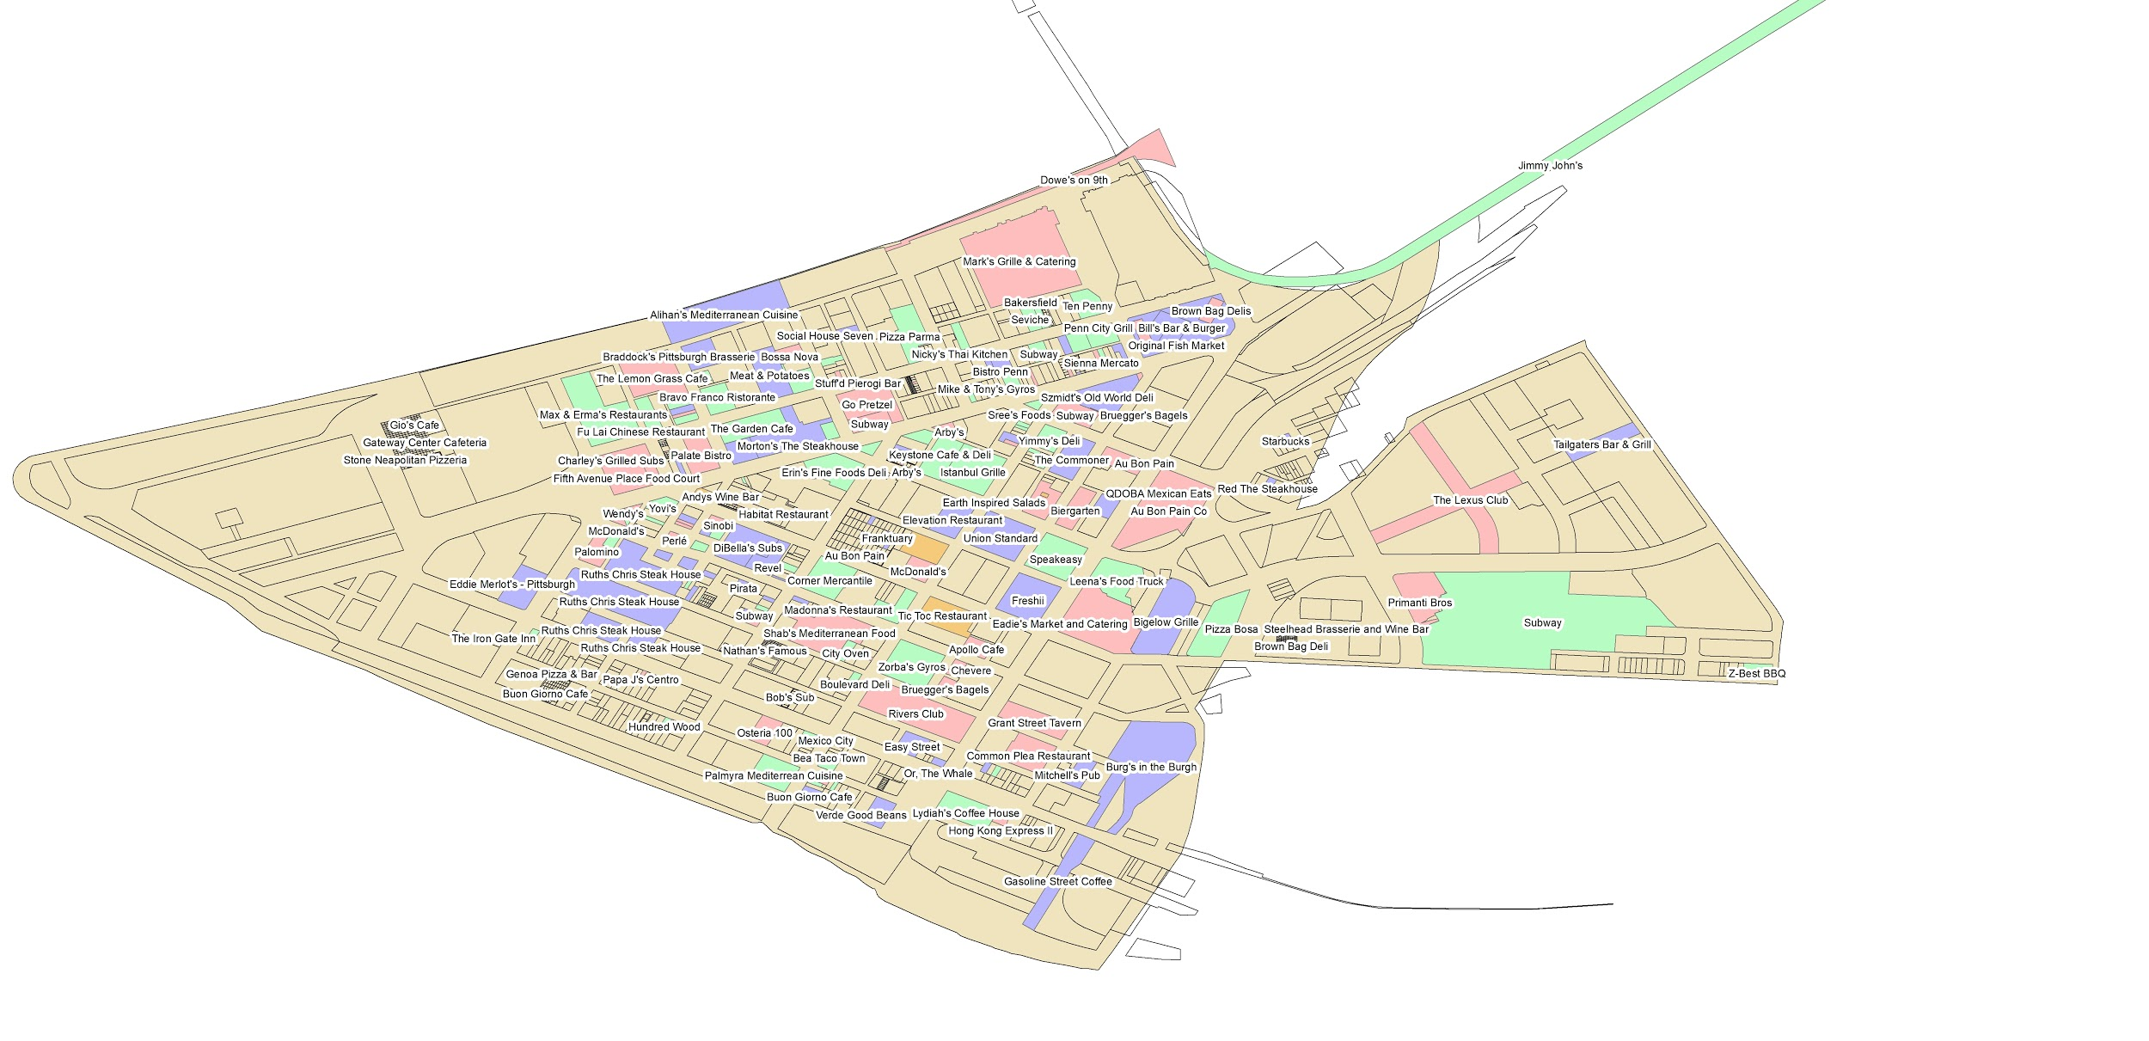
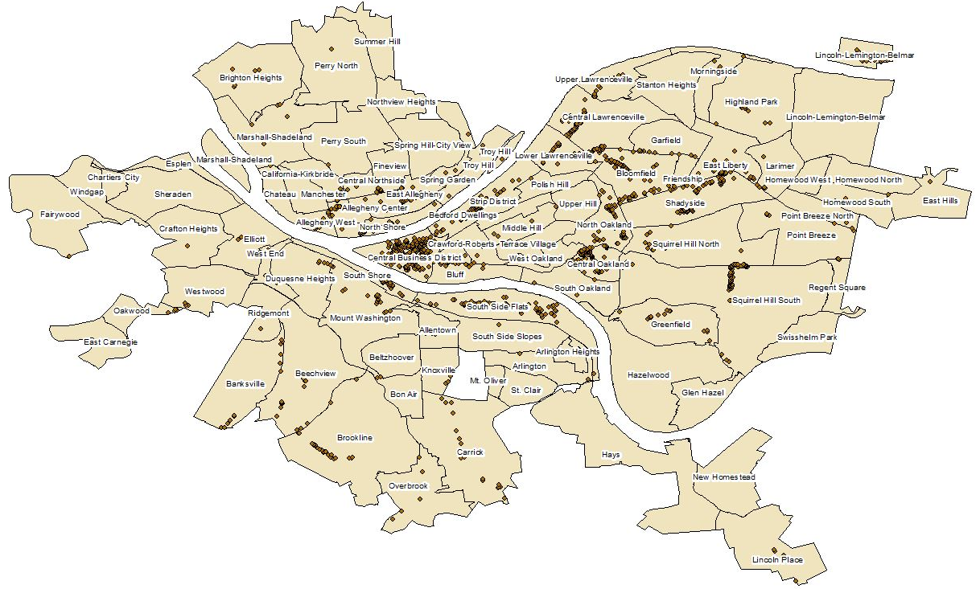
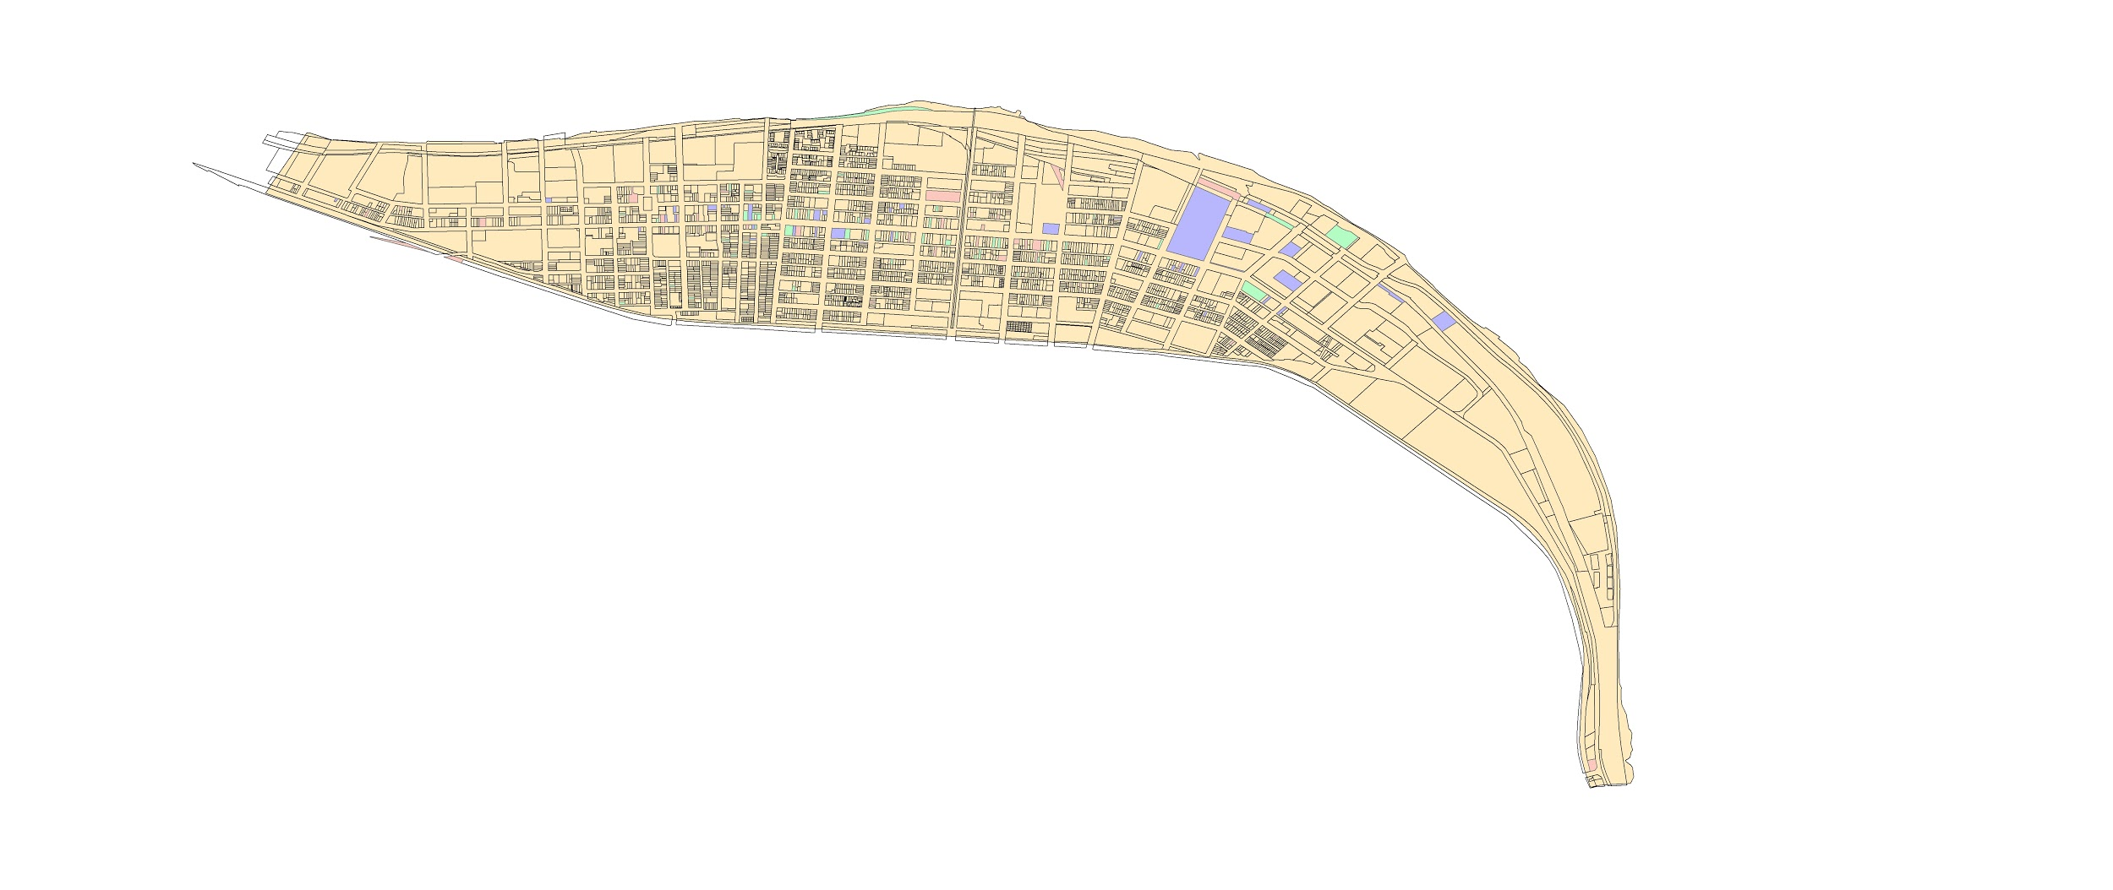
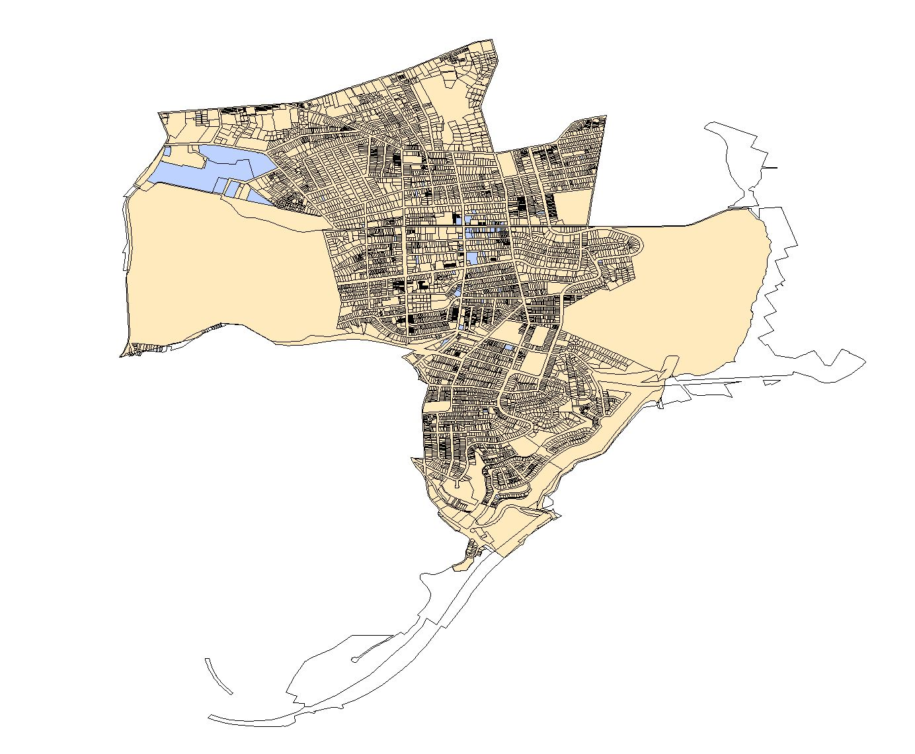
Filtering Data
After filtering, the dataset became more manageable and I was able to determine which areas I wanted to examine and restaurant characteristics I wanted to analyze.

Slide 11
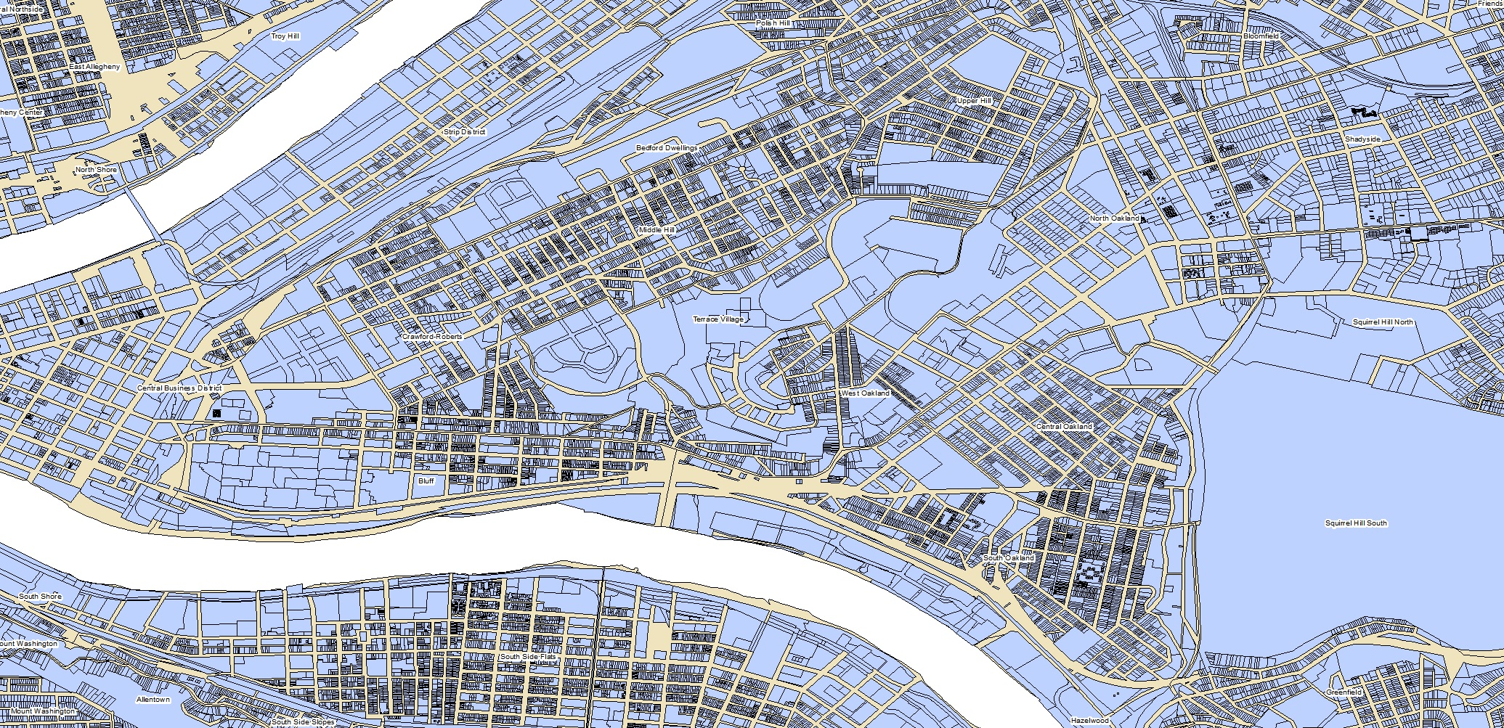
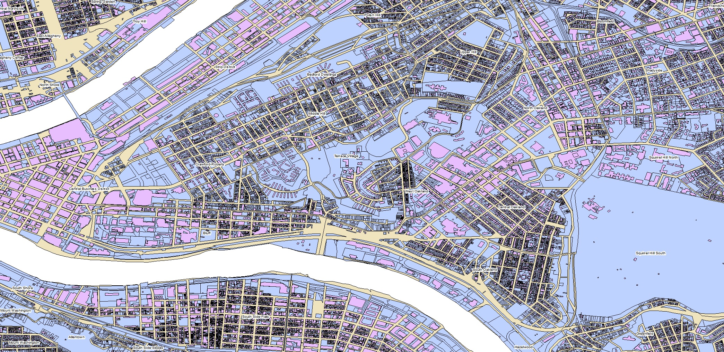
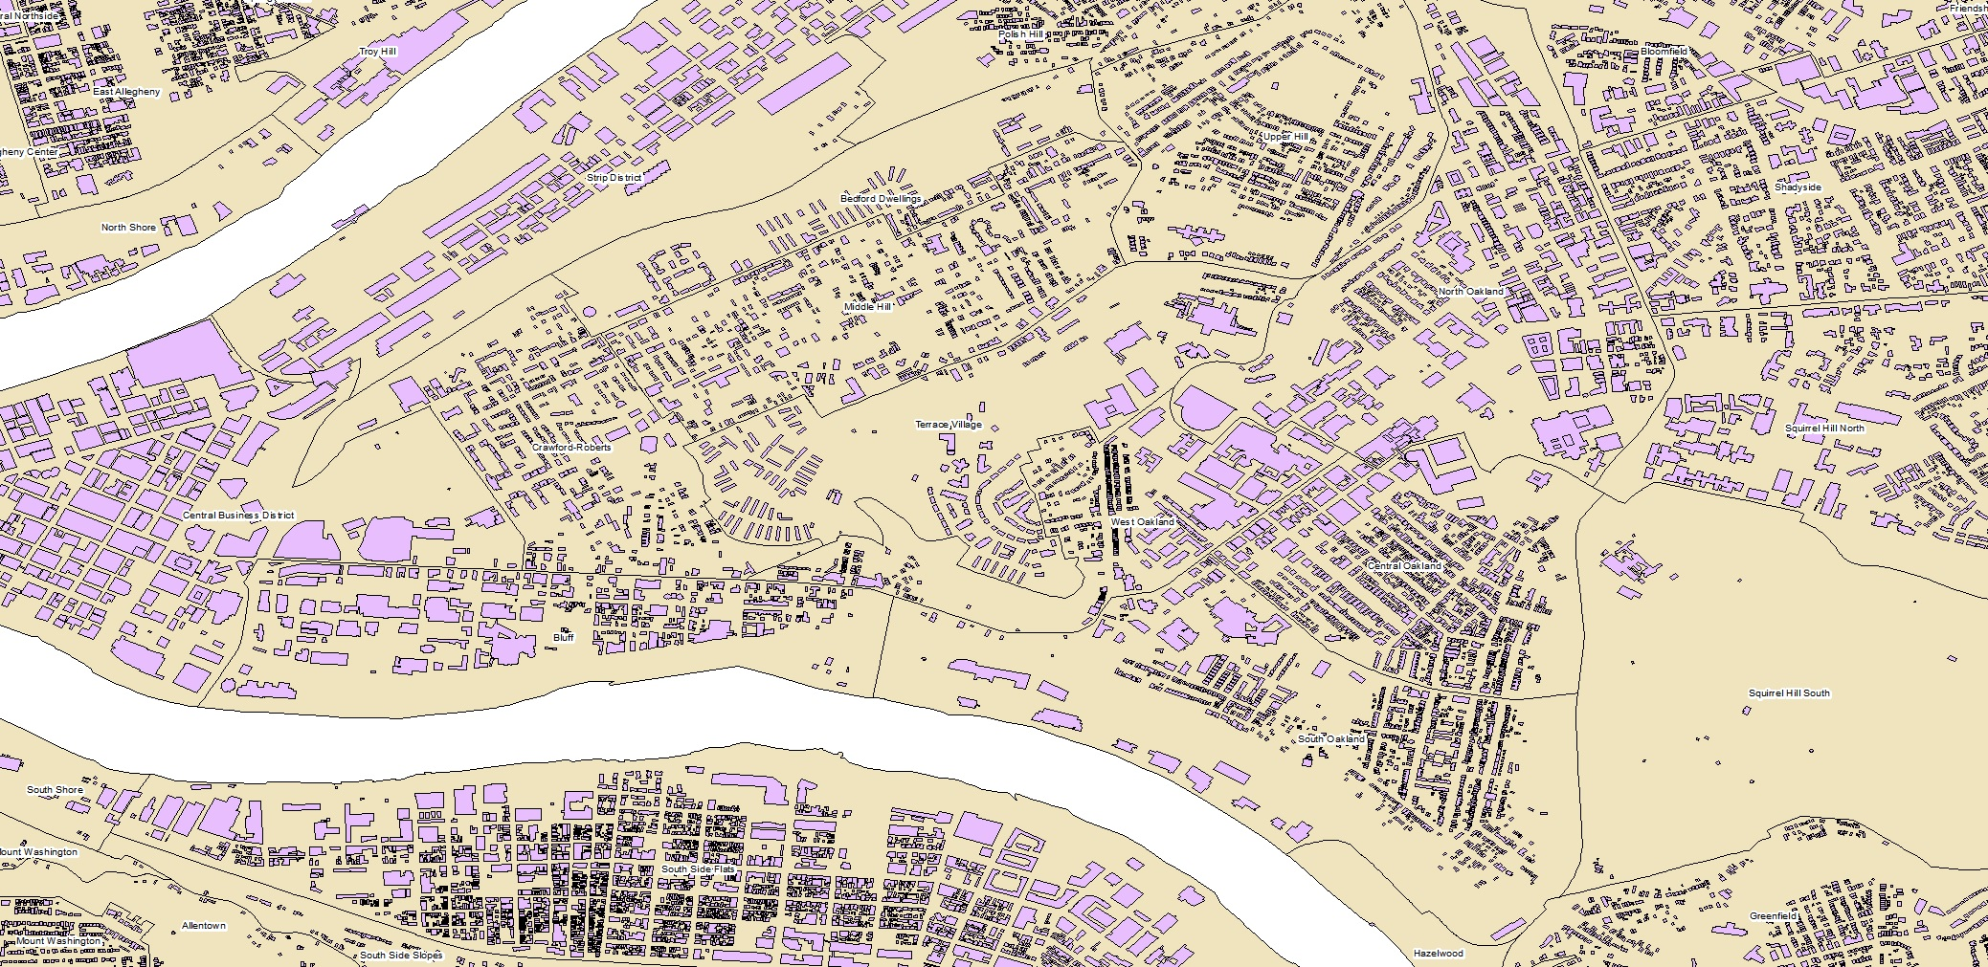
ArcMap Process
Parcels are boundary outlines of individual properties (2018)
Footprints are building outlines by roof line (2018)
Source: Pennsylvania Spatial Data Access

Slide 12

Descriptive Stats
3,680 Restaurants on Yelp in Allegheny County
And 1,540 are located in the city of Pittsburgh
115 Restaurant Types/ Categories
Including Pizza, American Food, Bars, Fast Food, & Many More
38 Yelp Restaurant Attributes
Such as Noise Level, GoodforKids, Business Parking, & More

Slide 13
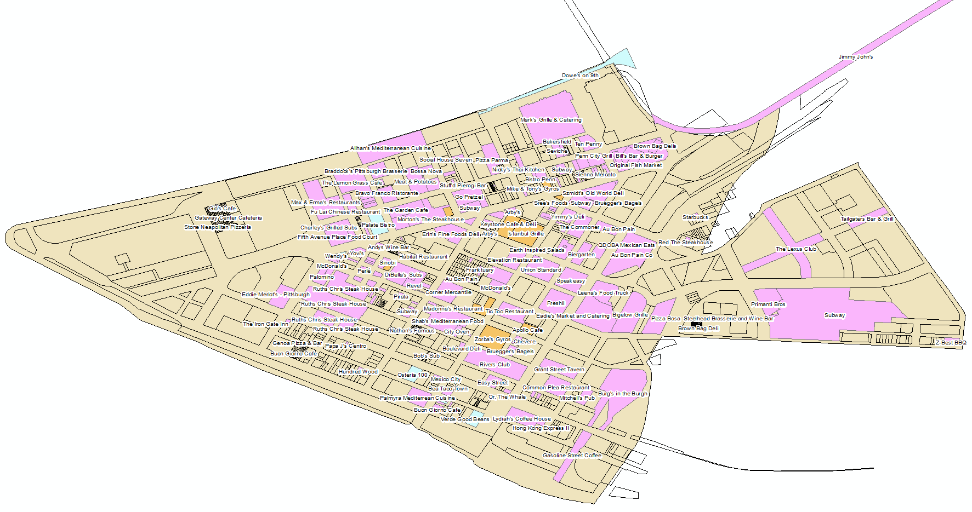
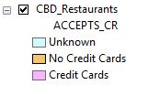
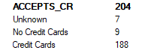
Central Business District - 204

Slide 14
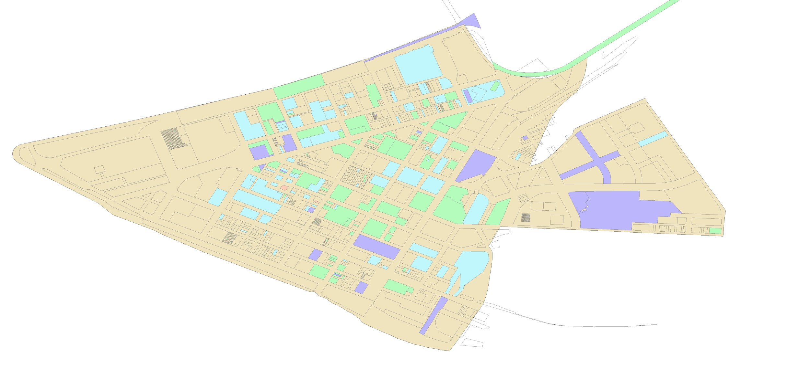
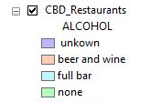
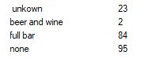
Central Business District - 204

Slide 15
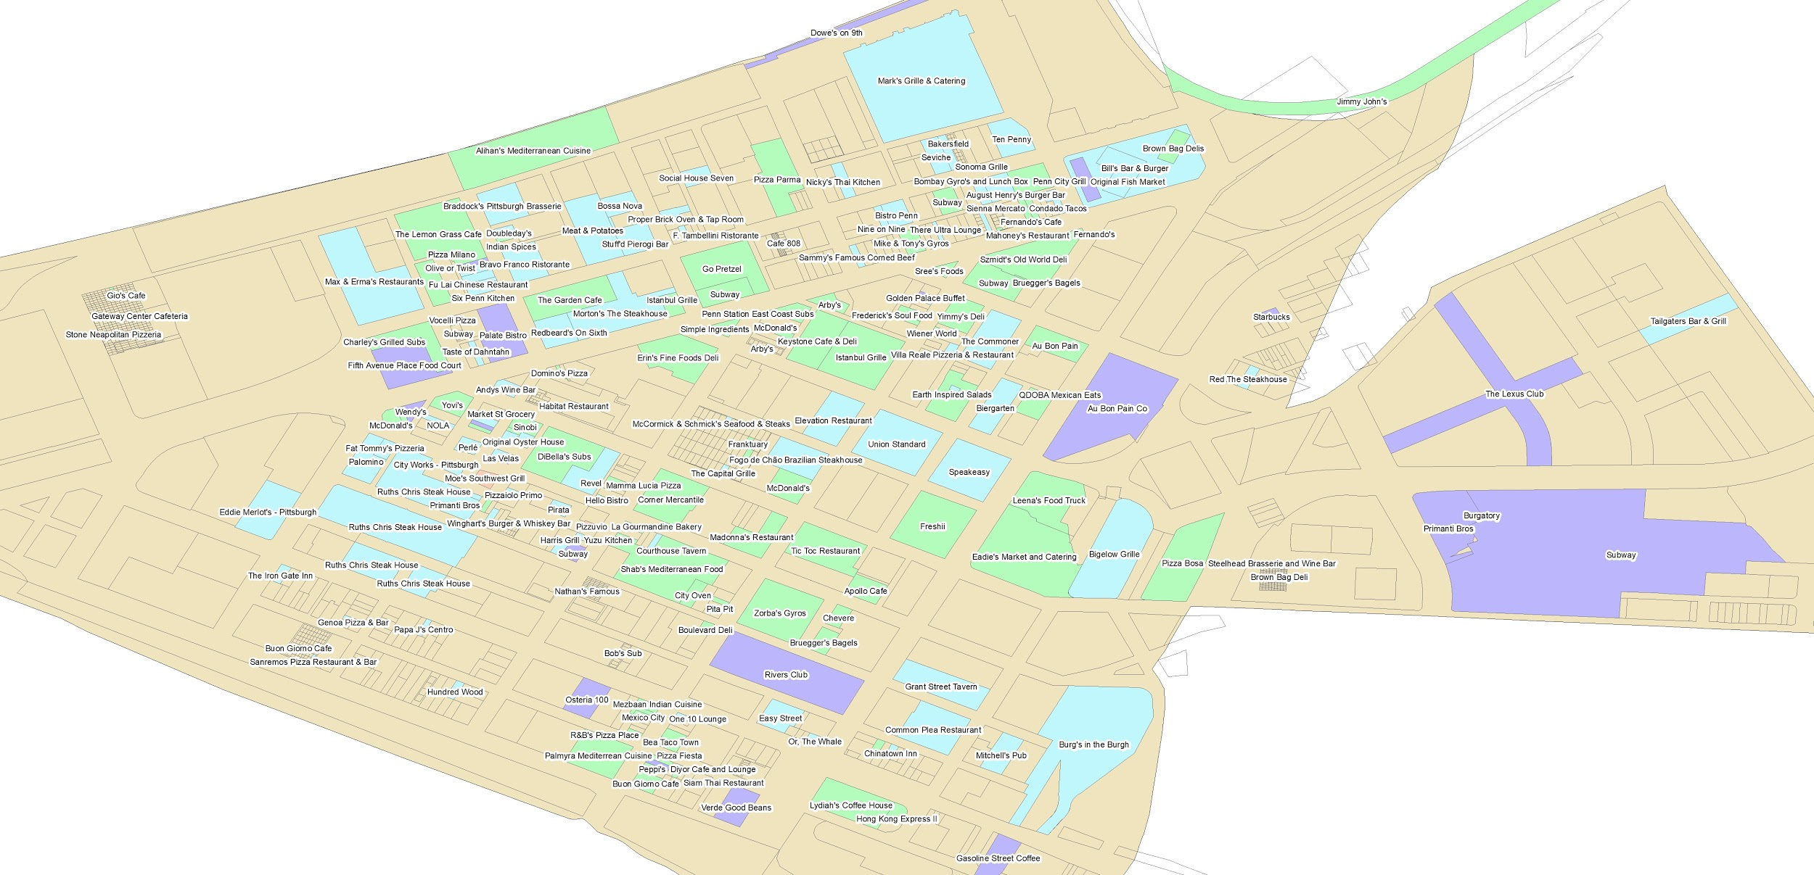
Central Business District - 204

Slide 16
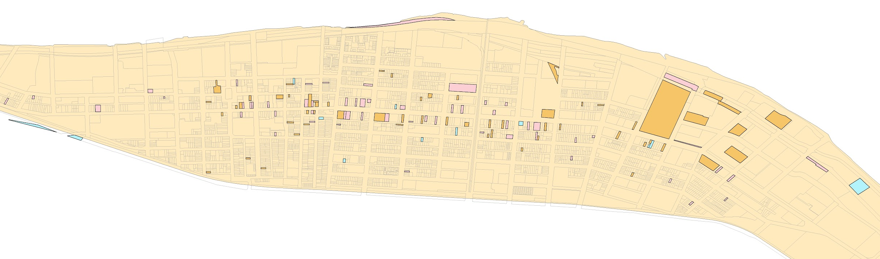
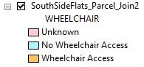
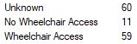
South Side Flats - 130

Slide 17
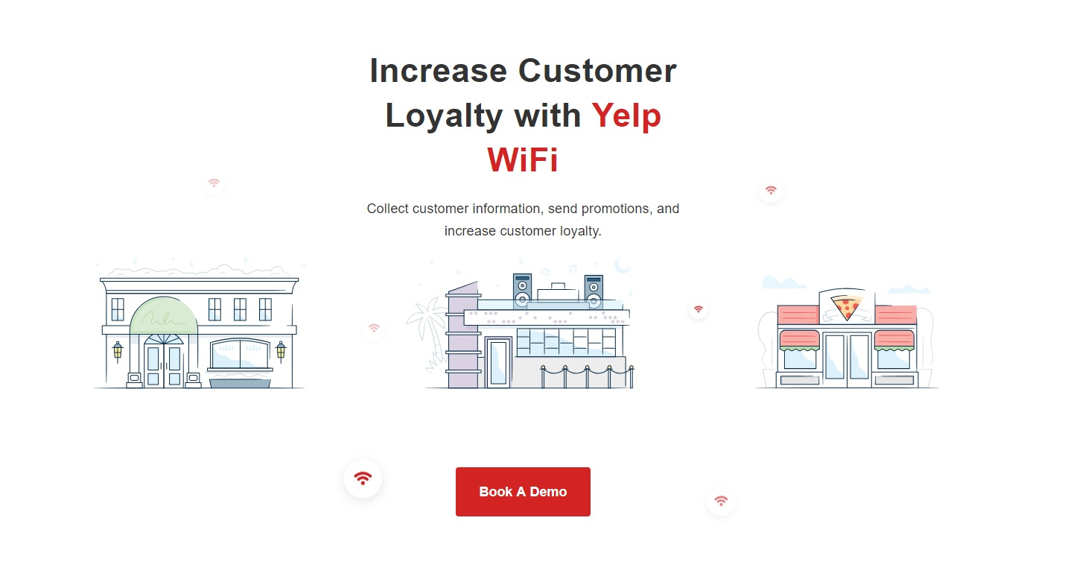

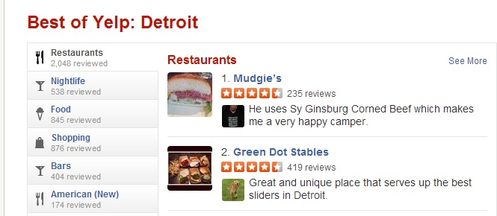
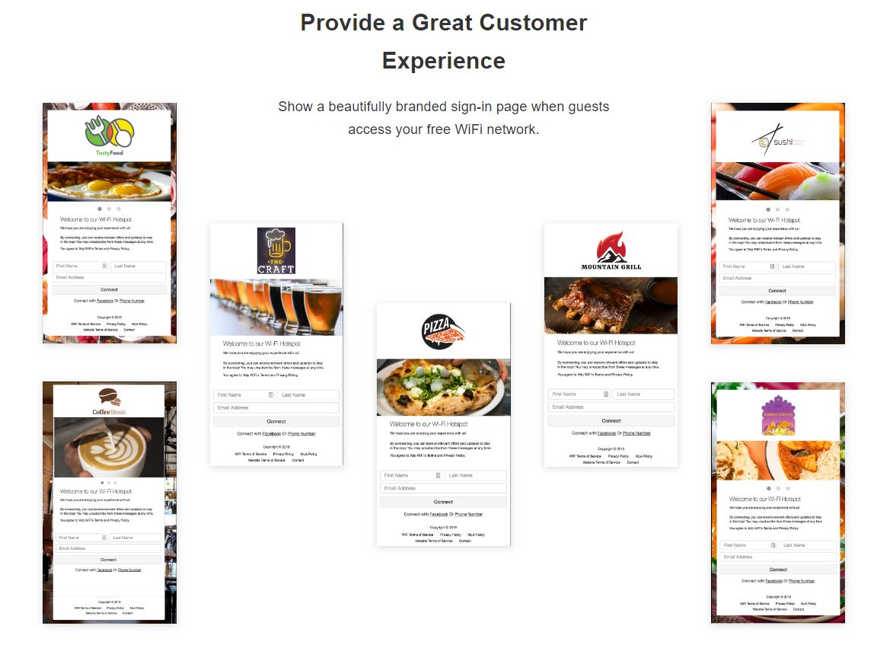
Question 1:
Do restaurants WITH WIFI have more STARS than restaurants with NO WIFI?
(Is there a relationship between WIFI and Rank?)

Slide 18
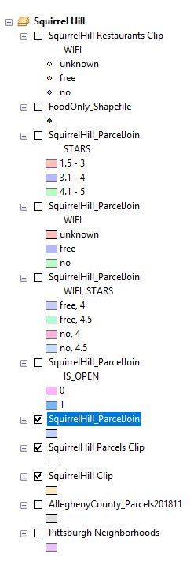
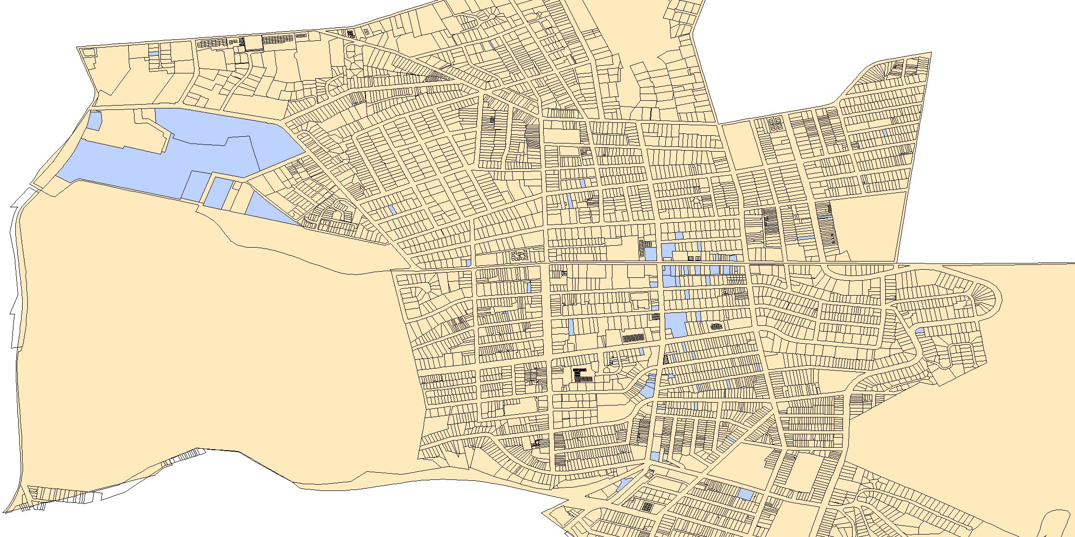
Map
Squirrel Hill Yelp Restaurants 83
(Actually 103)

Slide 19
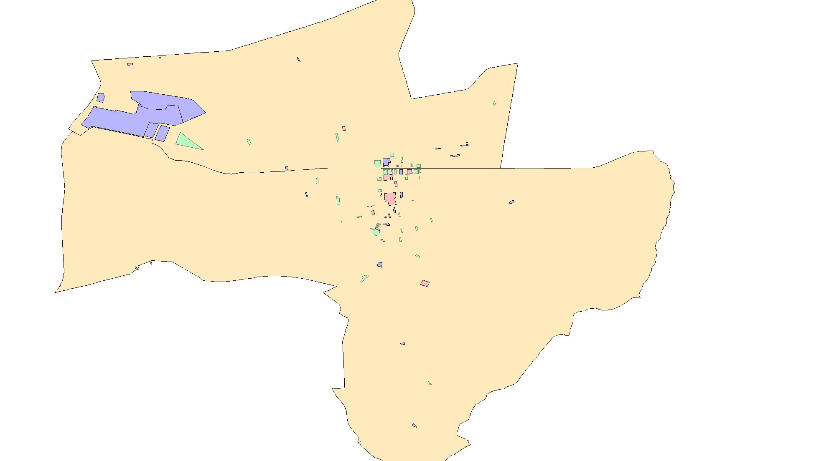
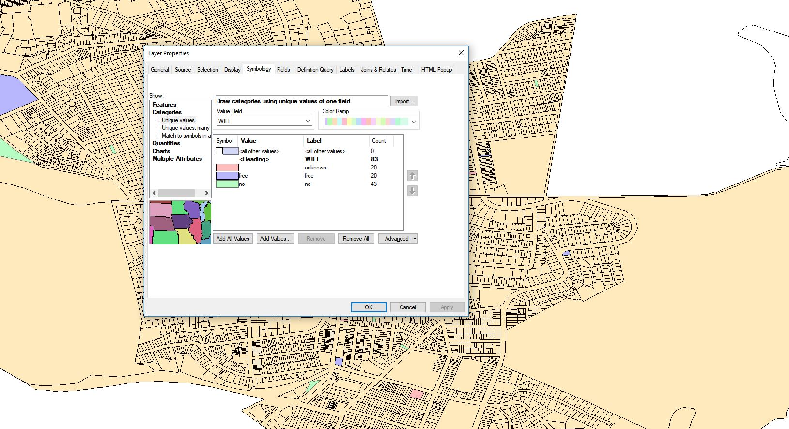
20 Unknown
20 Free
43 No

Slide 20
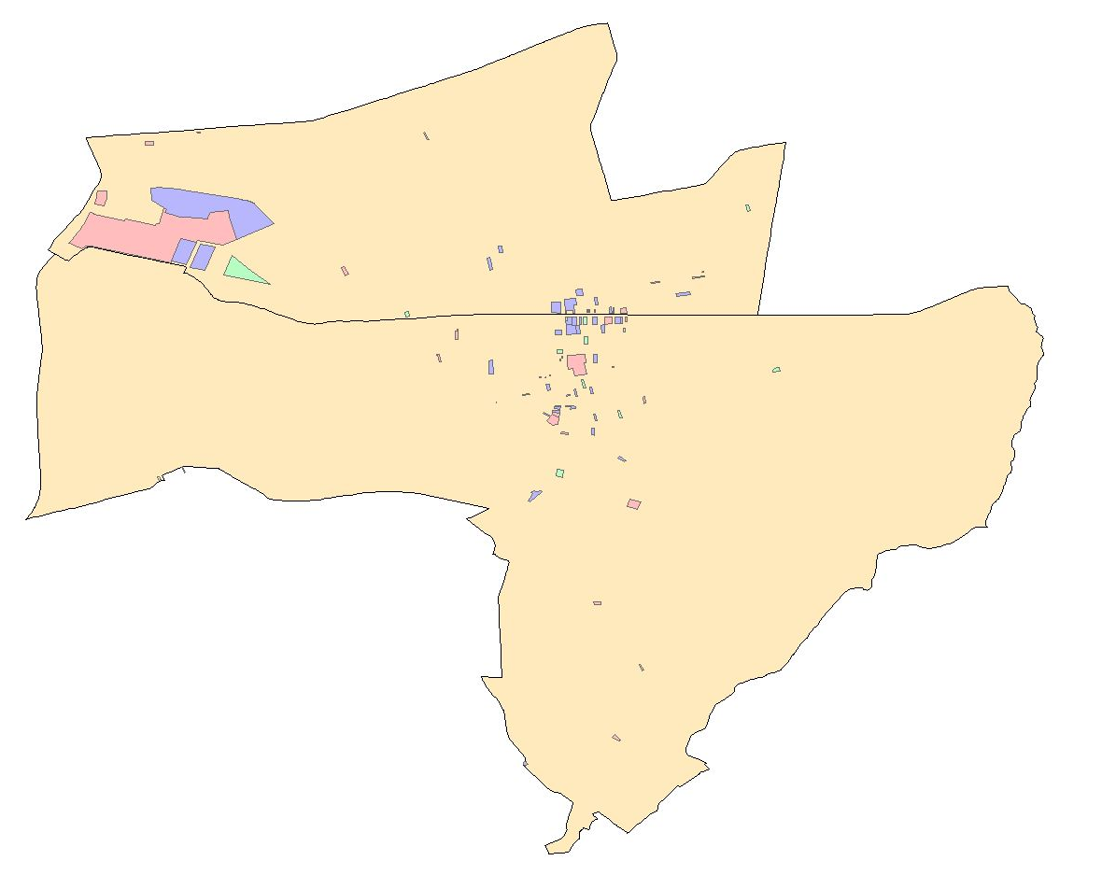
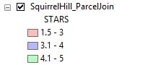
28 Low
40 Med
15 High

Slide 21
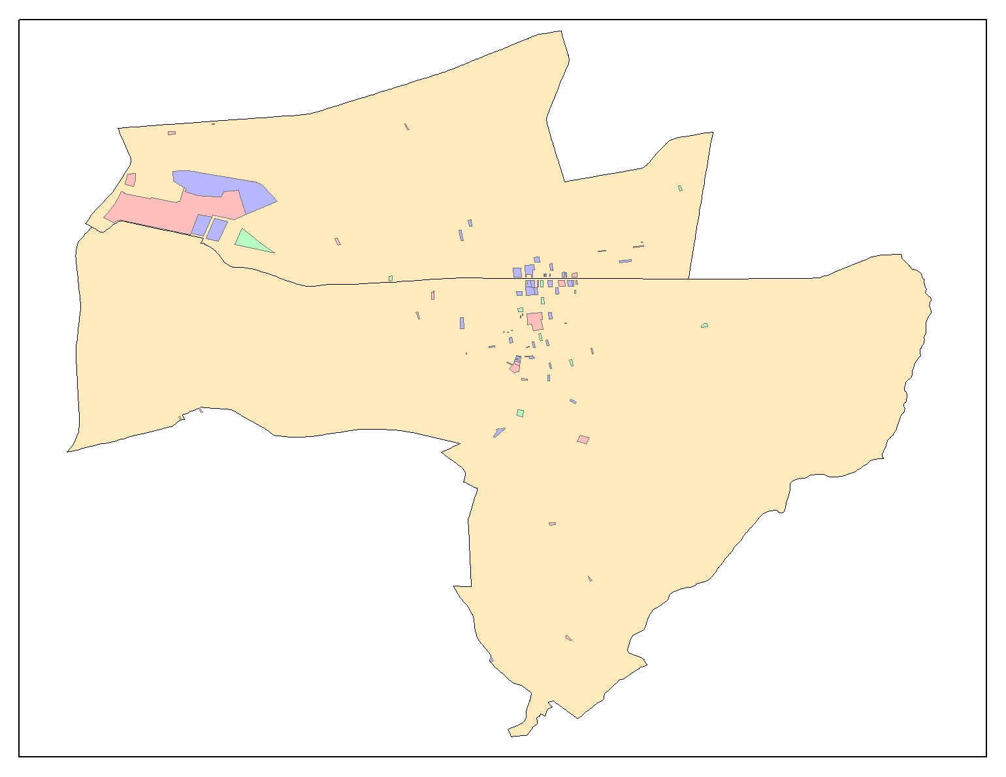
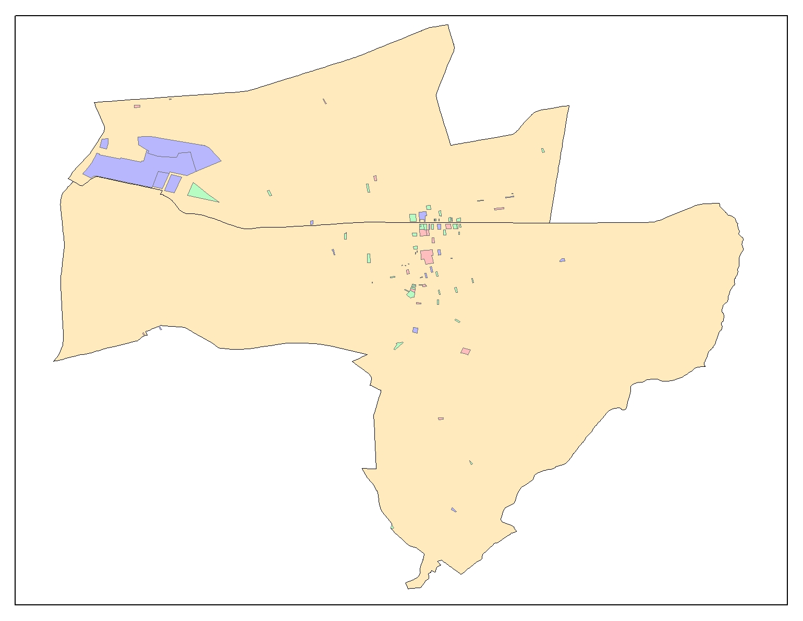
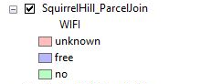
STARS
WIFI

Slide 22
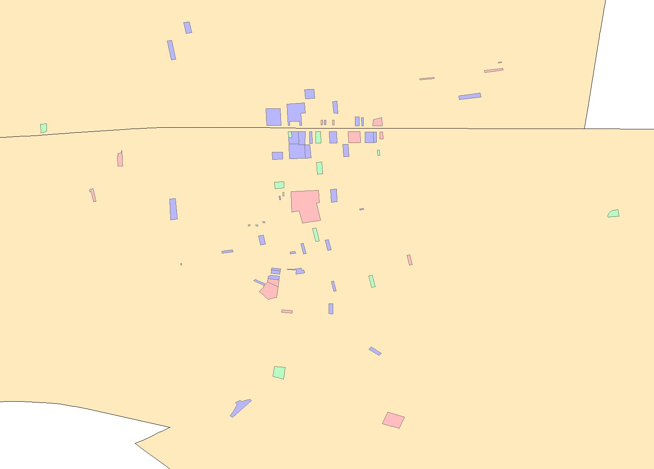
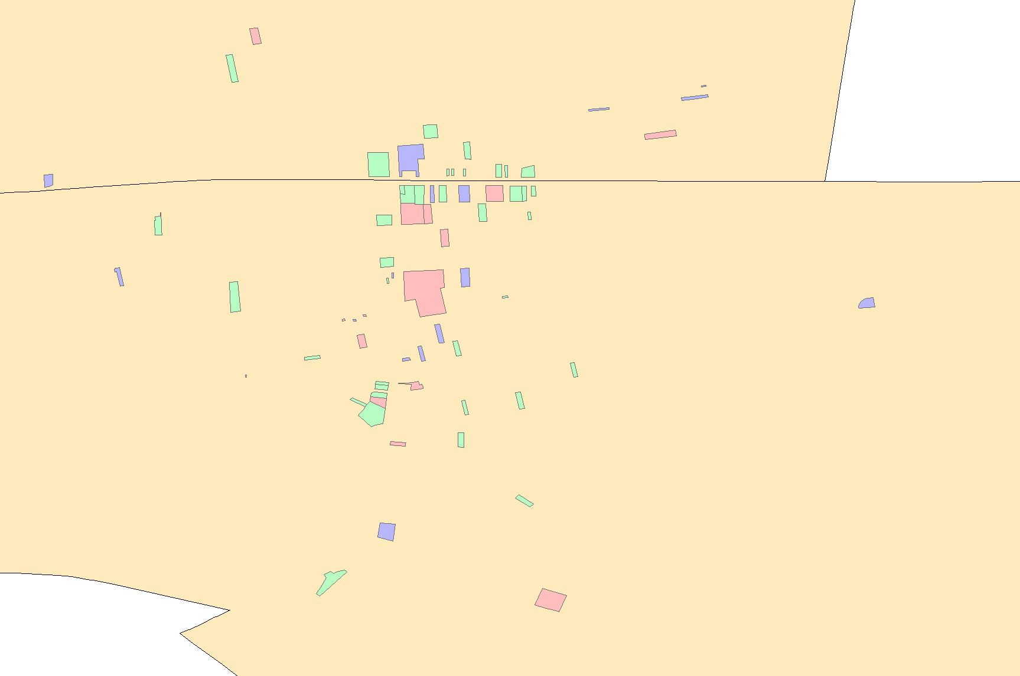
Map
STARS
WIFI

Slide 23
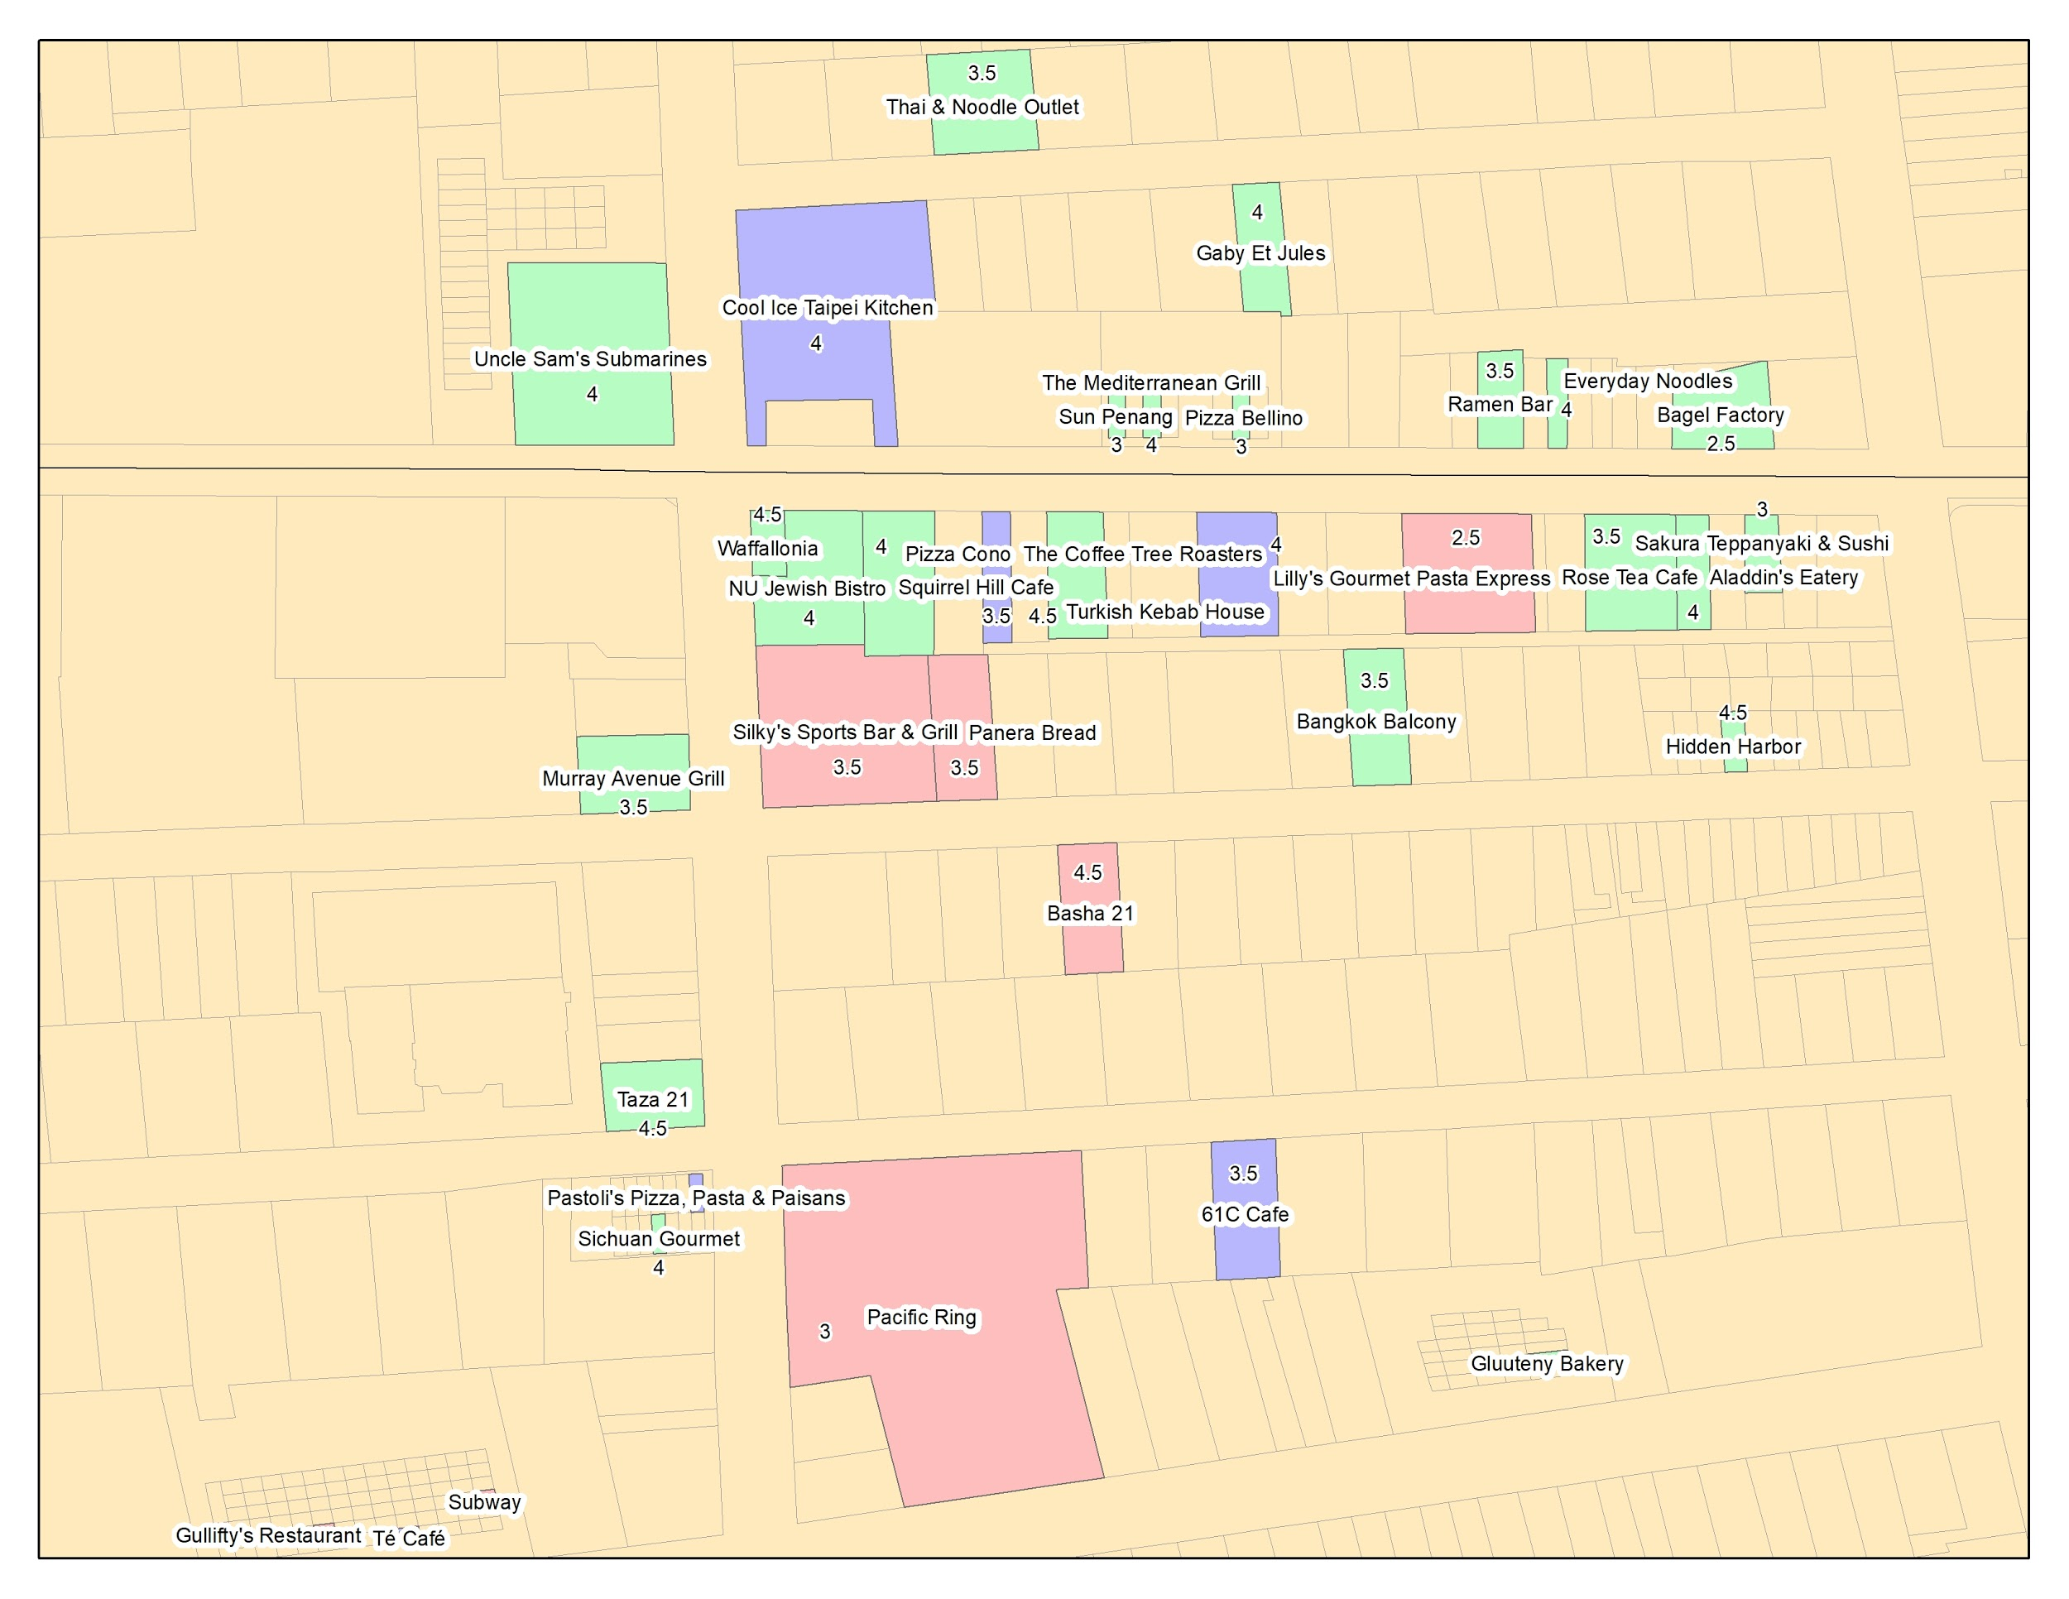
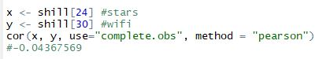
Findings
Both restaurants with and without WIFI have high ranks on Yelp. After determining the correlation coefficient, there was no linear relationship between WIFI and RANK.

Slide 24
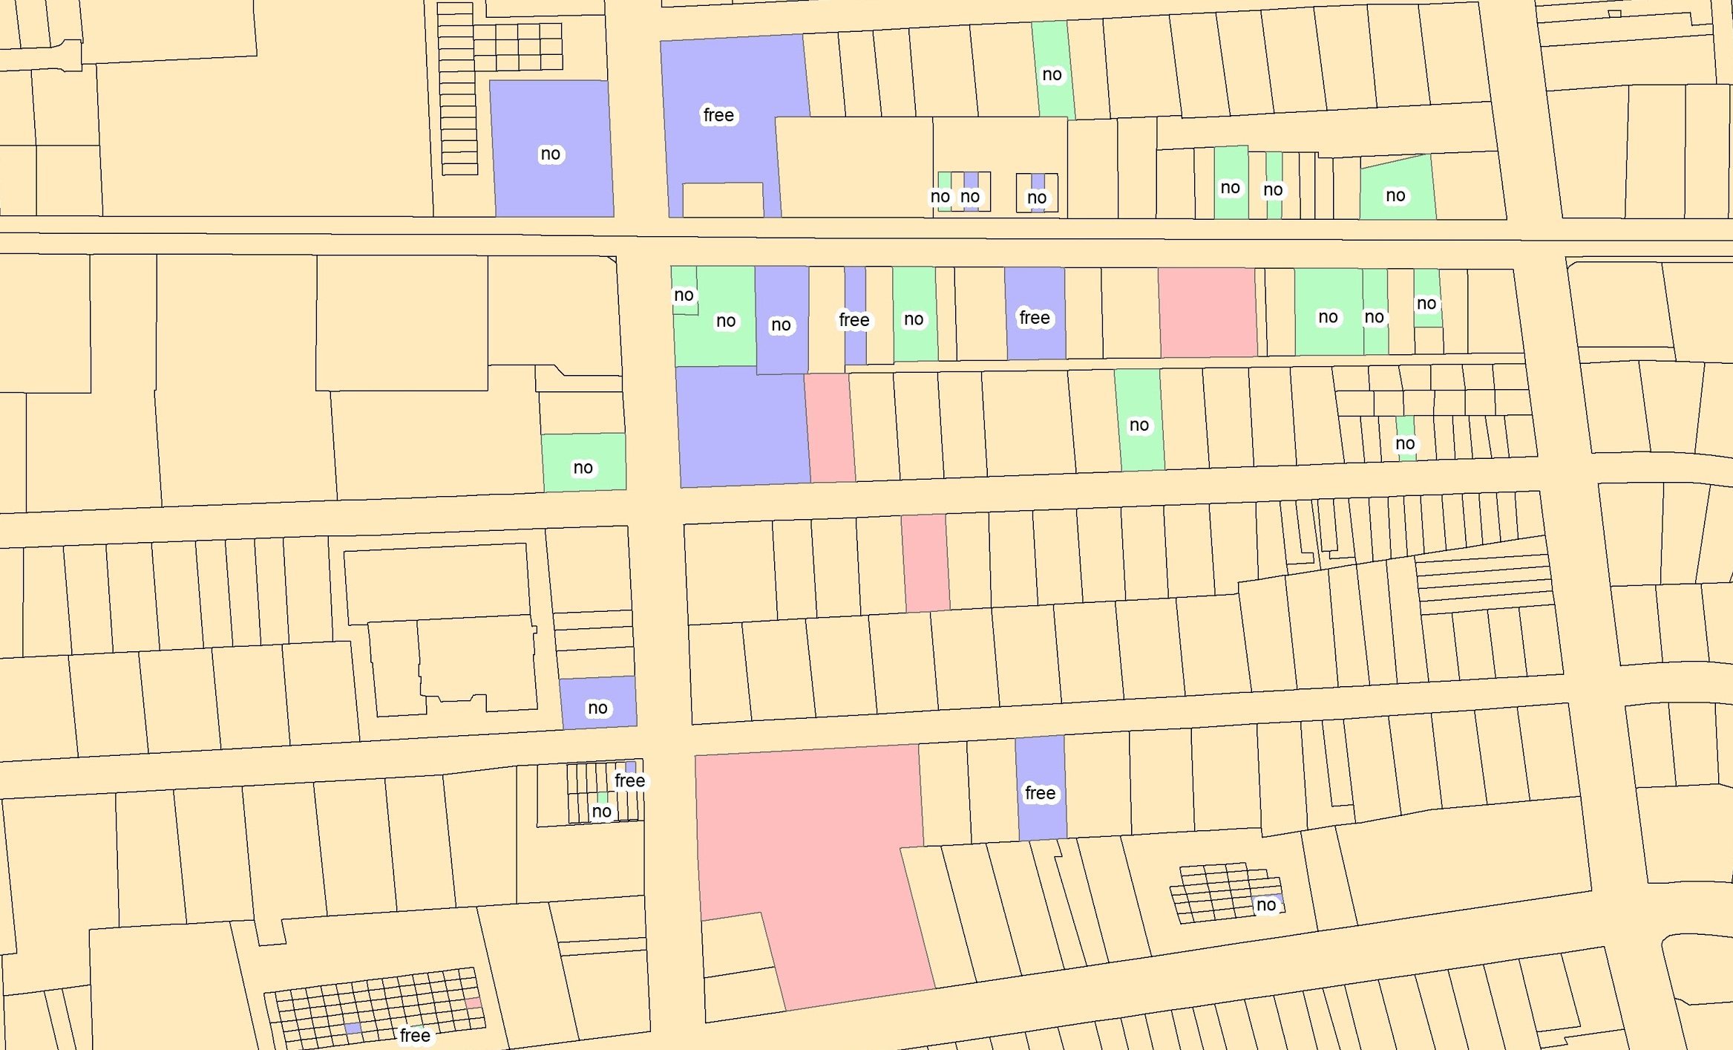
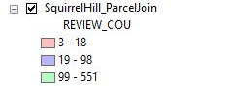
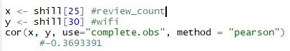
Findings
There was no apparent correlation between WIFI and RANK.
Weak negative linear relationship between REVIEW_COUNT and WIFI.
Review Count WIFI Access

Slide 25
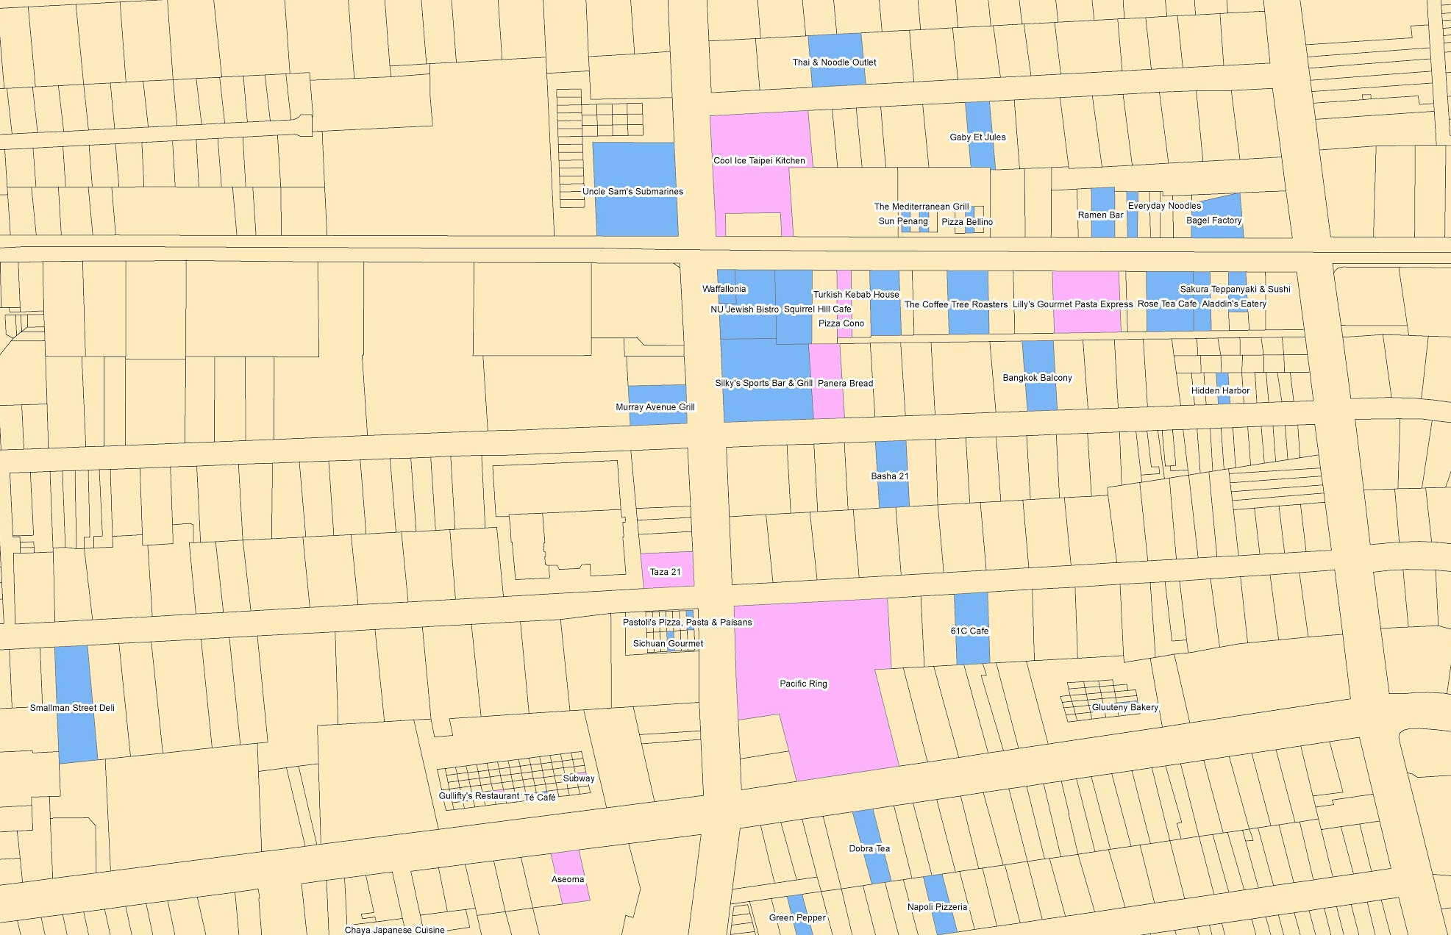
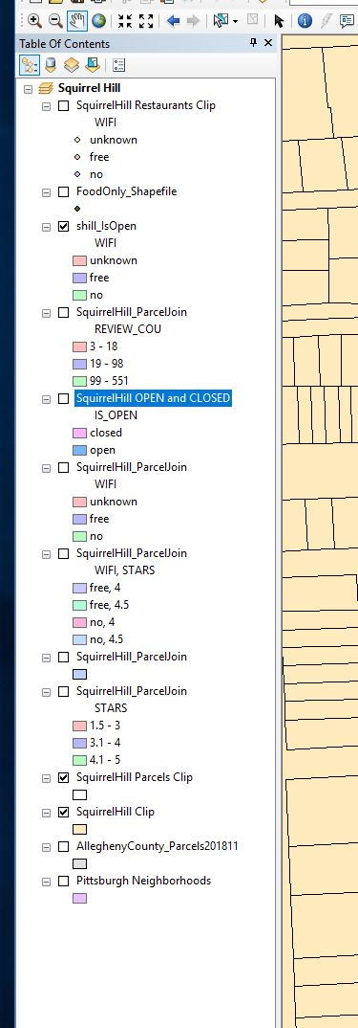
Findings
Almost a 24% of the 83 restaurants in Squirrel Hill restaurants are closed.
21 Closed
62 Open

Slide 26

Findings
7 Unknown
15 Free
40 No

Slide 27
Future Questions
Does picture quality or picture amount influence ranking/ star amount?
If an establishment has a significant amount of pictures does this help their ranking?
Positive vs. Negative reviews, how are the weighted? Do negative reviews on a profile distract people from the positive reviews?
Lessons Learned?

Slide 28

Thank You

Slide 29
Work cited for shapefile links
- city and county shapefiles https://data.wprdc.org/dataset/city-of-pittsburgh-gis-data
- buildings https://data.wprdc.org/dataset/allegheny-county-building-footprint-locations
- parcels http://www.pasda.psu.edu/uci/DataSummary.aspx?dataset=1214 , http://openac-alcogis.opendata.arcgis.com/datasets/allegheny-county-parcel-boundaries
- find identical https://gis.stackexchange.com/questions/115672/remove-duplicated-items-in-arc-attribute-table
- select attributes cheat sheet https://www.esri.com/news/arcuser/0405/files/fieldcalc_1.pdf
- understanding the symbology tabs http://pro.arcgis.com/en/pro-app/help/mapping/layer-properties/symbolize-feature-layers.htm
- understanding summarize tools https://doc.arcgis.com/en/arcgis-online/analyze/perform-analysis.htm

Slide 30
Work cited for academic articles
Tourist dining preferences based on reviews https://journals.sagepub.com/doi/full/10.1177/0047287517744672?utm_source=summon&utm_medium=discovery-provider&
Promotional marketing, word of mouth http://go.galegroup.com/ps/i.do?p=AONE&u=upitt_main&id=GALE|A344209646&v=2.1&it=r&sid=summon
Reviews and gentrification https://journals.sagepub.com/doi/full/10.1177/1469540515611203?utm_source=summon&utm_medium=discovery-provider
Yelp wifi https://www.yelpwifi.com/
Yelp content guidelines https://www.yelp.com/guidelines
Yelp ranking factors http://www.localvisibilitysystem.com/2012/08/23/yelp-ranking-factors/
Yelp contest page https://www.yelp.com/dataset/documentation/main
Filtering with stringr https://blog.exploratory.io/filter-with-text-data-952df792c2ba
Correlations https://www.dummies.com/education/math/statistics/how-to-interpret-a-correlation-coefficient-r/

